Slide 1
Healthcare/IoT Cybersecurity Testbed: Semester 2 Project Plan
By: Justin Bower, Nathan Maloney, and Ipule Pipi
Instructors/Advisors: Dr. Sudhakaran and Dr. Aydeger

Slide 2
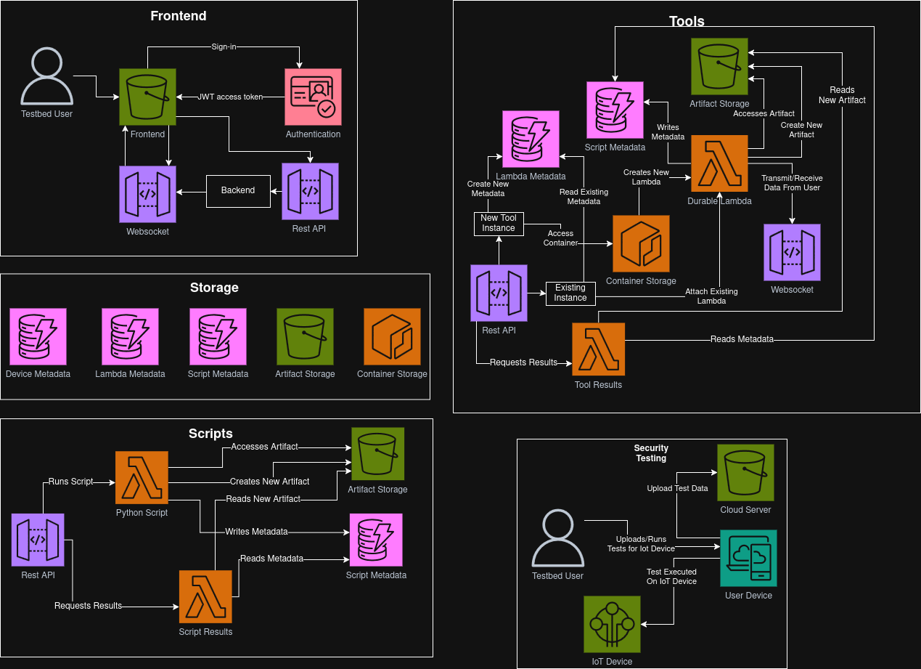

Slide 3
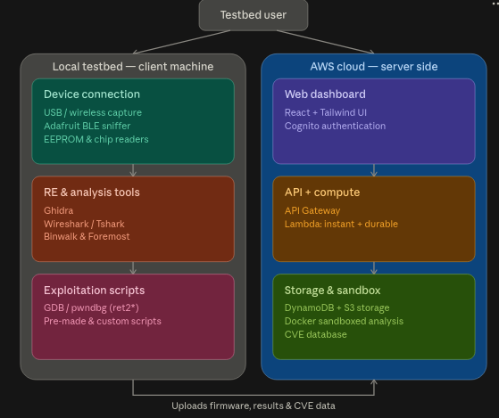

Slide 4
Key System Features
Users can connect a variety of IoT and medical devices that use standard interfaces, wired or wireless, to the testbed, enabling full device access, interaction, and manipulation.
Users can extract firmware directly from connected IoT and medical devices, obtaining complete firmware/binaries for detailed examination and vulnerability assessment.
Users can analyze firmware entropy to evaluate randomness and compression characteristics
Users can utilize industry-standard open-source tools to perform reverse-engineering tasks and comprehensive vulnerability research.
Users can input their own CVE lists, and automatically retrieve lists of known CVEs, which are stored server-side in a database.
Users can utilize pre-made scripts or upload custom exploitation scripts to rapidly test known, suspected, or new vulnerabilities, and potential attack vectors.
Users can perform all connection, extraction, analysis, and exploitation tasks through an intuitive client-side graphical interface, thereby streamlining the process for both novice and experienced users.
Users can create and upload documentation, or integrate existing documentation via GitHub, with all materials stored in server-side storage.

Slide 5
What makes this novel?
A testbed that tightly integrates many disparate tools, automates firmware extraction, firmware analysis, entropy analysis, decryption, into one platform, is a novel approach to cybersecurity analysis.
The testbed reduces the background knowledge needed for manufacturers or researchers to reverse-engineer Medical/IoT devices while unifying the reverse-engineering toolset.
The testbed is specifically tailored for IoT and medical hardware, which is often proprietary and notoriously difficult to analyze.
The testbed allows for direct firmware extraction from connected devices via standard interfaces and therefore streamlines the process of obtaining firmware/binaries for vulnerability assessment.
The testbed allows for built-in entropy analysis combined with pre-existing decryption techniques to uncover encrypted or obfuscated firmware sections more efficiently.

Slide 6
What makes this novel?
The testbed has support for both ready-made exploitation scripts and user-developed custom scripts provides flexibility to confirm known weaknesses or explore new attack vectors.
The testbed will have backend/web support for supporting the local GUI that lowers the barrier to entry so that both novice and experienced users can perform complex tasks with greater ease.
The testbed will have documentation storage and a CVE database with associated automations, accelerating the research process via targeted testing, and expedited sharing of results
The testbed’s benefits scale with the difficulty of reverse-engineering each device and contribute to a more secure future for IoT and Medical devices by making thorough examination more accessible.

Slide 7
What tools we will be using?
Overall Project/Multi-purpose
Github: Version control and code collaboration tool
VSCode: IDE for general development, testing, and demo purposes
VSCode Dev Container: Standardized development environment
Python: Ideal for scripting purposes and simple integrations with many tools via pre-existing libraries/APIs
Communication:
Email: Official correspondence and sending attachments
Discord: More informal communication for day-to-day planning and coordination

Slide 8
What tools we will be using?
Reverse Engineering Tools:
Ghidra: Open source tool for binary/firmware analysis
Wireshark/Tshark (GUI and CLI): Open source tool for network analysis
Binwalk CLI: Useful for examining files, extracting sub-files, and entropy analysis
Foremost CLI: Useful for examining files, extracting sub-files, and entropy analysis
GDB/pwndbg: Useful for low-level Assembly-language reverse engineering and vulnerability research
Adafruit nRF51822-based Bluefruit LE Sniffer: USB device, drivers, and matching API for network capture (Bluetooth traffic logging as pcap files)
Various Wireless Adapters: USB device, drivers, and matching API for network capture (Wifi/RF traffic logging as pcap files)
EEPROM and Live Chipset Reader: Useful for pulling firmware directly off PCBS
Soldering irons: For connecting and disconnecting electrical connections
Solder wiring (lead or non lead): For establishing and holding electrical connections
Copper wick: For wiping unused/excess solder
Alligator clips: For holding PCBs and providing temporary connections where soldering is unnecessary
Overhead lights: To provide clarity when soldering and doing smaller electrical tasks

Slide 9
What tools we will be using?
Frontend and Backend Tools:
React: Frontend of website
TailwindCSS: Styling of website
JavaScript/TypeScript: Website base language/API calling functionality
Terraform: Deployment of services to cloud in a reproducible fashion that allows for easy transfer of the stack to a different AWS account
Amazon Web Services (AWS): Provides web server hosting, database backend, and other miscellaneous compute needs listed below:
Docker: Isolates tasks for security, ease of deployment and platform management
DynamoDB: Database architecture backbone; keeps data organized, minimizes storage space complexity and computational overhead via data structuring
S3 Object Storage: Simple artifact storage and web hosting
Instance Lambda Functions: Used to optimize speed of repetitive tasks and minimize memory space complexity
Durable Lambda Functions: Allows for easier control of long running cloud analysis that may involve waiting for user input
API Gateway: Allows for a secure connection between local and cloud applications
Cloudfront: Improved web latency and increased max traffic capacity
Cognito: AWS managed sign on portal with authentication tokens and account management

Slide 10
Milestone 4 Task Matrix
Team Member | Main Responsibility Category | Sub Task 1 | Sub Task 2 | Sub Task 3 | Sub Task 4 | Sub Task 5
Justin | Reverse Engineering, Vulnerability Research, Cyber Tooling/ Demos, Local GUI, Project management | Prepare a demo of the Adafruit device and pcap file extraction using Wireshark/ Tshark | Complete CVE Research for wifi chipsets and enter said CVEs into the database for demo | Study I2C sensor and plan integration into project, such as an oximeter demo, and planning how it will interface in the main project | Respond to professors emails, communicate/ coordinate with team members, attend professor meetings, create, and write most of the Project Plan | Wipe the lab computer and install Linux (Got permission already)
Nathan | Web/Database Backend and Demos | Create the infrastructure to allow for cloud based analysis | Prepare a demo of cloud based analysis of device attack results | Integrate artifact storage and database with local and cloud infrastructure | Create secure API endpoints to allow local and cloud applications to interact | Setup router for testbed and interfacing devices in the network

Slide 11
Ipule | Web Front End and Cloud Backend Integration | Complete the authenticated device management workflow for adding and viewing IoT/medical devices through the web dashboard. | Integrate device creation and retrieval with AWS API Gateway, Lambda, DynamoDB, and Cognito so device records are associated with the authenticated user. | Implement the end-to-end firmware upload workflow, including firmware reservation, SHA-256 metadata, presigned S3 upload, upload completion verification, and retry support for interrupted upload attempts | Implement the firmware viewing interface so users can retrieve and display firmware metadata, upload status, filename, version, file size, and other associated information for each registered device. | Strengthen firmware upload state management and authorization by using firmware/attempt identifiers to prevent stale or conflicting retries and ensure users can access only their own devices and firmware.
Jordan | RE/VR, Cyber Tooling/ Demos, Local GUI | Continue local GUI work so users can trigger the RE/analysis/exploitation tools | Continue developing pre-made exploitation scripts for GDB/pwndbg (ret2*) | Develop pre-made exploitation scripts for Ghidra and/or integrate existing Ghidra scripts | Begin live firmware extraction using EEPROM/chipset readers | Install necessary tools on Linux machine

Slide 12
Milestone 5 Tasks
Ipule - Web Front End and Cloud Backend Integration
Integrate the firmware-analysis workflow into the web dashboard so a user can select an uploaded firmware image and initiate an analysis job.
Develop frontend interfaces for viewing analysis jobs, execution status, and generated results associated with a specific device and firmware version.
Integrate the dashboard with the backend analysis APIs and storage architecture developed by the team, including retrieval of analysis outputs and artifacts.
Improve device and firmware workflow state handling by displaying clear pending, ready, processing, completed, and failed states where applicable.
Implement user interface protections and validation for analysis actions so jobs can only be started against valid firmware owned by the authenticated user.
Nathan - Web/Database Backend and Demos
Create proof of concept docker/sidecar deployments are properly set up with the tooling of the DS18B20 I2C sensor work
Starting working for DS18B20 I2C sensor (and similar sensor’s) exploitation can be verified by a new user through their own replication of the pipeline
Testing security of tooling and platform itself, as part of the containerization and isolation of environment

Slide 13
Milestone 5 Tasks
Justin - RE/VR, Cyber Tooling/Demos, Local GUI, Project Management
Begin integrating Adafruit and Wireshark/Tshark
Continue development of pre-made exploitation scripts for wifi/bluetooth exploitation
Keep project/team members moving and ensure Professors (customers) are happy
Maintain email/Discord communications constantly
Create intermediate start-to-finish proof of concept demo
Jordan - RE/VR, Cyber Tooling/Demos, Local GUI
Continue local GUI work so users can trigger the RE/analysis/exploitation tools
Build out Ghidra-based reverse engineering workflows for extracted firmware, producing analysis outputs
Begin integrate entropy analysis and file segmentation tools (Binwalk/Foremost)
Continue development of pre-made exploitation scripts for wifi/bluetooth exploitation
Begin I2C sensor integration into project

Slide 14
Milestone 6 Tasks
Ipule - Web Front End and Cloud Backend Integration
Complete the end-to-end web workflow from device registration and firmware upload through analysis execution and result retrieval.
Integrate available reverse-engineering and vulnerability-analysis outputs into the dashboard, such as extracted firmware information, entropy results, discovered files, vulnerabilities, or generated artifacts provided by the analysis backend.
Improve the dashboard user experience by organizing devices, firmware versions, analysis jobs, and outputs into a clear workflow suitable for researchers and manufacturers.
Perform integration and edge-case testing of authentication, device ownership, firmware upload/retry behavior, analysis initiation, and result retrieval.
Prepare the web application for the final project demonstration by resolving integration issues, improving error handling, and documenting/demoing the complete user workflow.
Jordan - RE/VR, Cyber Tooling/Demos, Local GUI
Finalize device connections, to firmware extractions, to entropy/decryption, to exploitation/analysis paths, creating multiple local pipelines that feeds results to the web backend
Finalize local GUI work so users can trigger the RE/analysis/exploitation tools locally
Complete and test the exploitation scripts against real device/firmware data
Prepare demos of the cyber tooling integrations for the final presentation
GDB/pwndbg
Ghidra demo

Slide 15
Milestone 6 Tasks
Justin - RE/VR, Cyber Tooling/Demos, Local GUI, Project Management
Finalize CVE entries and RE documentation for the final demo
Prepare demos of the cyber tooling integrations for the final presentation
Adafruit/Wireshark
Binwalk/Foremost
Prepare a full end-to-end RE demo (through aforementioned local pipelines) for the final presentation as a video recording
Keep project/team members moving to ensure Professors are satisfied with progress
Maintain email/Discord communications constantly with team members and Professors
Nathan
Finalize AWS permissions and backend security using least-privilege access.
Complete integration between local analysis tools, cloud services, S3, DynamoDB, and the web application.
Finalize and test containerized cloud analysis and isolation.
Perform end-to-end testing and prepare the cloud/backend workflow for the final demo.

Slide 16
Thanks for listening!
Questions?

